Slide 1
Unlocking Customer Loyalty: TravelTide's Path Forward
Customer Segmentation & Rewards Program

Slide 2
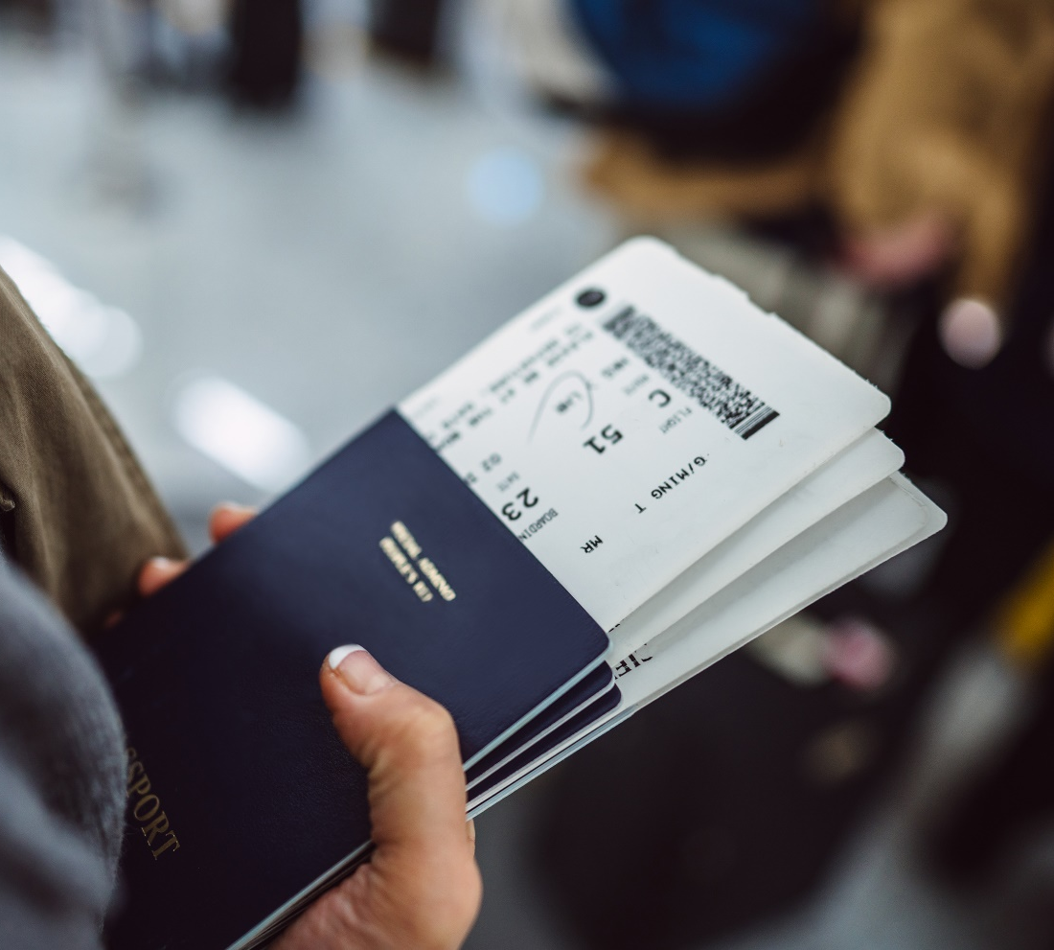
Unlocking Customer Loyalty: TravelTide's Path Forward
Objective:
Making Our Customers Feel Special with Tailored Rewards
Approach:
Using Smart Data to Personalize Your Travel Rewards Experience
Notes:
Good afternoon everyone, and thank you for being here. Today, we're diving into an exciting roadmap for TravelTide's future. Our objective is simple yet impactful: we want to make our customers feel special by offering them rewards that truly resonate with them. And how are we doing this? By smartly using data to personalize their travel experience. So, let's embark on this journey to unlock customer loyalty and propel TravelTide forward.

Slide 3

Objectives
Identify distinct customer segments
Align segments with tailored travel perks
Enhance customer retention
Notes:
Let's start by outlining our objectives for this analysis.
Firstly, we aimed to identify distinct customer segments within our user base. Understanding our customers' behaviors and preferences is the first step in offering them a service that they can't resist.
Secondly, we wanted to align these segments with tailored travel perks. The idea is to offer perks that are not just attractive, but also relevant to each segment.
And finally the ultimate goal is to enhance customer retention. We believe that a personalized approach to rewards will not only make our customers happy but also make them stay with us for the long haul.
These objectives guided our analysis and helped us focus on what truly matters: our customers.

Slide 4
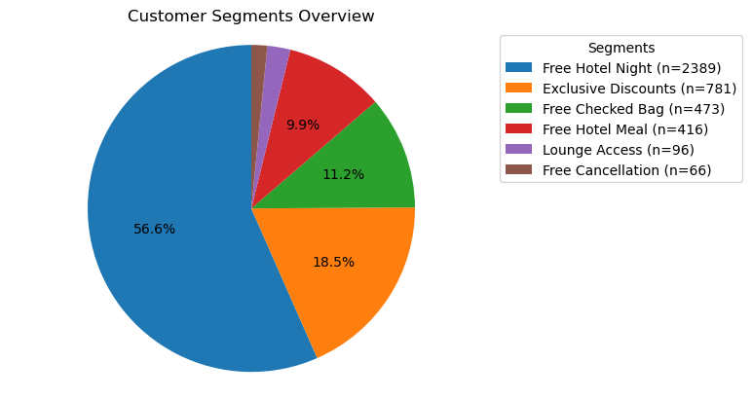
Key Findings: Who Are Our Customers
High Value Travelers
Exclusive Discounts
The Planner’s Choice
Free Hotel Meal
Long Stay Guests
Free Night Hotel Stay with Flight
The Global Traveler
Complementary Lounge Access
Families and Groups
Free Checked Bag
The Flexible Traveler
Free Cancellation
Notes:
In this slide, you'll see a pie chart that represents the different customer segments we've identified, along with the tailored perks that would most appeal to each group. For instance, 'The Long-Stay Guests' are a significant portion of our customer base, and they would highly value a free hotel night with their flight bookings. This approach allows us to be strategic in offering perks that not only delight our customers but also make business sense for TravelTide.
By aligning these perks with specific customer segments, we're not just enhancing customer satisfaction; we're also setting the stage for increased loyalty and, ultimately, revenue growth

Slide 5
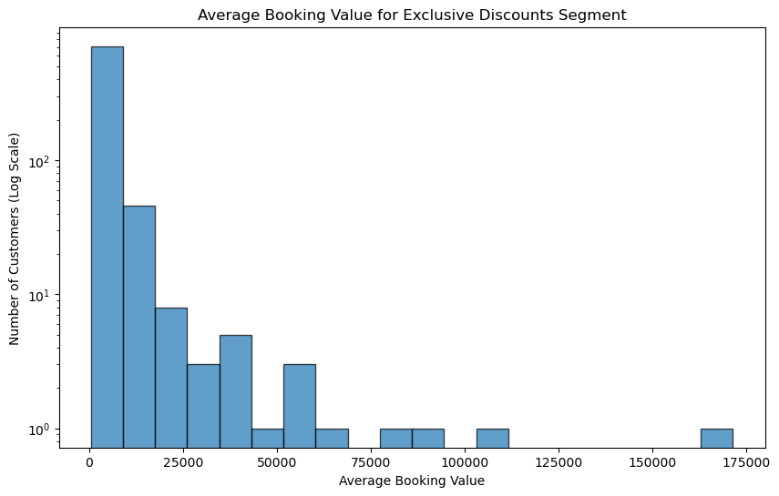
High Value Travelers
Criteria
Top 15% of customers by spend during the cohort period
Average Customer Lifetime Value
$11,511
Size of Segment
781
Recommended Perk
Exclusive Discounts
Notes:
In this segment, we have our top spenders, making up the top 15% of our customer base. These are the customers who contribute significantly to our revenue and are ideal candidates for our most exclusive perks. With an average lifetime spend of over $11,000, these customers are looking for premium experiences, and we recommend offering them exclusive discounts as part of our rewards program. These customers potentially would want a premium tier of the rewards program offering enhanced travel experiences. Our top customer has spent a total of $208,658 on two trips!
The chart shows the distribution of the customers in this segment. We have used a logarithmic scale to better show the relative distribution of the numbers as it will compress the high numbers and expand the lower numbers allowing us to focus on patterns and distribution rather than getting lost in large numbers.

Slide 6
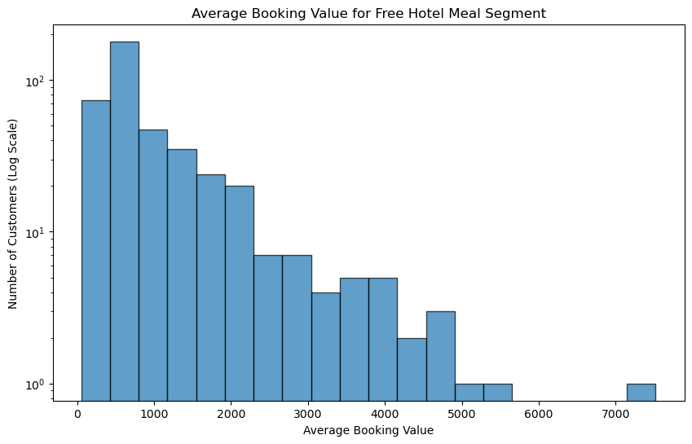
The Planner’s Choice
Criteria
Early Bookings and 1-Night Stays
Average Customer Lifetime Value
$2,495
Size of Segment
416
Recommended Perk
Free Hotel Meal
Notes:
In our next segment, we have 'The Planner's Choice,' which consists of travelers who book well in advance (90 days) as well as travelers who are booking 1-night stays. This segment is perfect for perks that add value without breaking the bank. With an average booking value of $2,495 and 416 travelers in this category, we recommend offering a Free Hotel Meal as part of our rewards program.
Travelers booking well in advance are trying to get the best bang for the buck for their travel dollar, before any discounts. Giving the option to have a free meal at their hotel is a little extra value. With the travelers booking 1-night stays, further – those checking in before 6pm, having a nice meal after checking into their room would be a very welcome perk.
The chart you see here shows the distribution of the average booking values for this segment. Just like before, we've used a logarithmic scale to give you a clearer view of the distribution, making it easier to identify patterns and opportunities for targeted engagement.

Slide 7
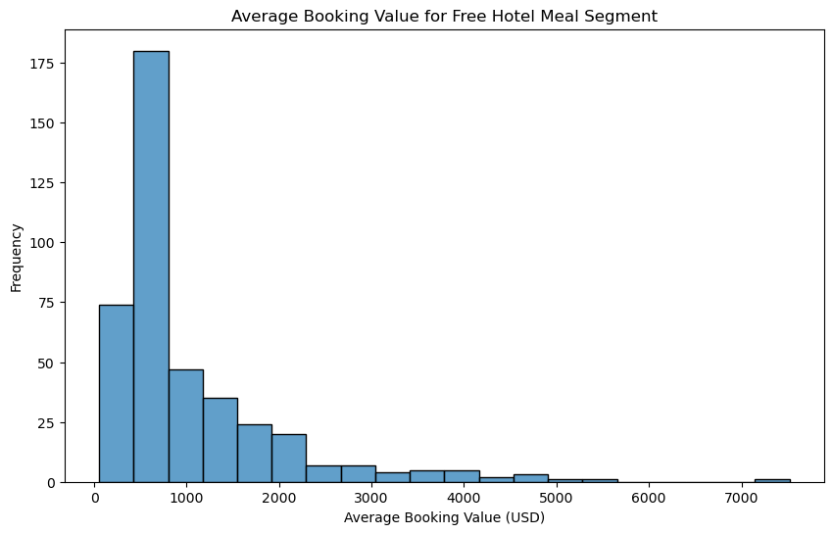
The Long-Stay Guests
Criteria
Trips of 4 nights or more
Average Customer Lifetime Value
$1,886
Size of Segment
2,389
Recommended Perk
Free Night Hotel Stay with Flight
Notes:
In this segment, we focus on 'The Long-Stay Guests,' travelers who book trips that last 4 nights or longer. With over 800 travelers in this segment booking trips that are a week or longer, this group is ideal for perks that enhance their extended stays. We recommend offering a Free Night Hotel Stay with Flight as part of our rewards program.
These travelers are not just looking for a place to stay; they're looking for an experience. Offering a free night can be a significant incentive for them to extend their trips even further, and it opens the door for upselling additional services like car rentals and theme park tickets.
The chart you see here shows the distribution of the average booking values for this segment. Unlike the previous segments, the distribution here is more balanced, making it easier to identify patterns and opportunities for targeted engagement.

Slide 8
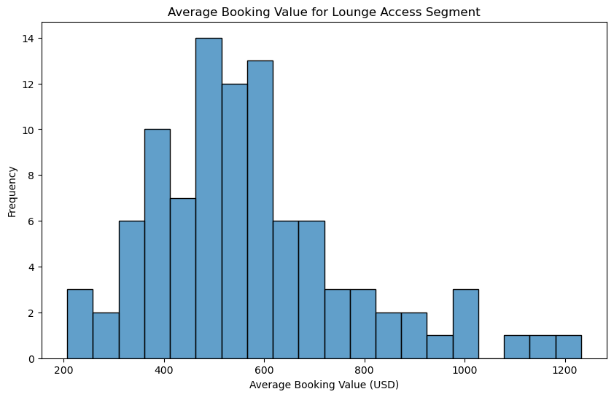
The Global Traveler
Criteria
International Travelers
Average Customer Lifetime Value
$2,261
Size of Segment
96
Recommended Perk
Complementary Lounge Access
Notes:
In this segment, we focus on 'The Global Traveler,' a group that primarily consists of international travelers. This segment is relatively small, with 96 travelers, but it's a segment that we expect to grow as international travel continues to rebound post-pandemic. The average lifetime value for customers in this segment is approximately $2,261.
Now, let's talk about the perk we recommend for this segment: Complementary Lounge Access. Lounge access is a highly sought-after amenity for international travelers. It's not just a place to relax; it's a status symbol. Offering this perk can significantly enhance the travel experience for these customers and make them more loyal to our brand.
The histogram you see here shows the distribution of average booking values for this segment. You'll notice that it's fairly normally distributed, which means we have a good mix of spending behaviors within this segment. This is valuable information as we consider how to tailor our rewards program.
In summary, 'The Global Traveler' segment may be small now, but it has significant growth potential. By offering Complementary Lounge Access, we can make a strong impression on these travelers and encourage them to choose our services for their future international travels.

Slide 9
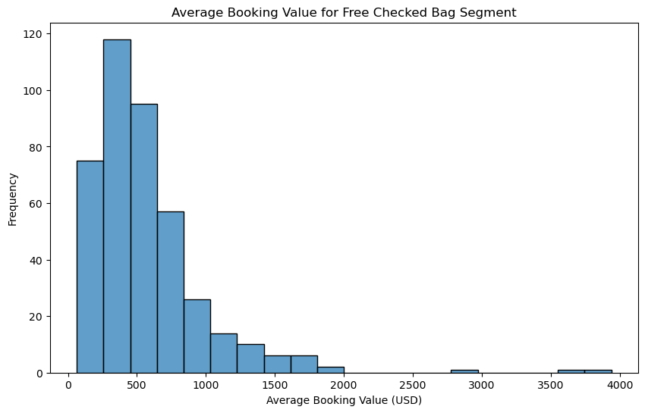
Families and Groups
Criteria
Families: Married with Children
Groups: 6 or more airplane seats OR 3 or more hotel rooms booked
Average Customer Lifetime Value
$1,085
Size of Segment
473
Recommended Perk
Free Checked Bag
Notes:
In this segment, we focus on the Family and Group travelers, a segment that includes 473 travelers. These are individuals who are either married with kids or are part of a larger group booking. They represent a unique opportunity for us, as they are often responsible for multiple bookings at once, making them a valuable segment despite their lower average lifetime value of $1,085.
Our data shows that every traveler in the cohort, not just this segment, who booked a flight also checked a bag. This makes the 'Free Checked Bag' perk an ideal match for this group. It's a low-cost perk, usually valued between $30-$40, that can serve as an effective enticement for these travelers. The goal here is not just to encourage a single booking but to convert them into long-term customers.
The histogram on this slide shows the distribution of the average booking values for this segment. As you can see, the distribution is slightly right-skewed, with a few outliers past $2,000. However, it's not skewed enough to warrant a logarithmic scale, so we've kept it linear for easier interpretation.
By offering a free checked bag, we aim to increase the lifetime value of these customers and encourage repeat bookings.

Slide 10
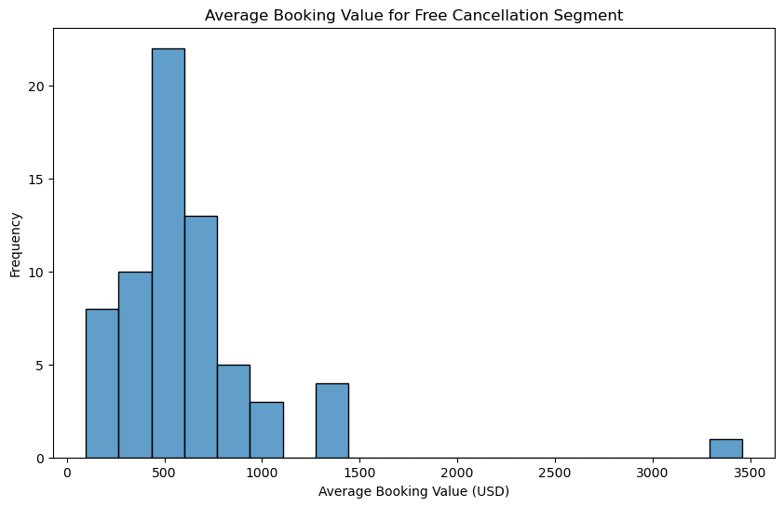
The Flexible Traveler
Criteria
Have a session with the sole intention of cancelling a booking
Average Customer Lifetime Value
$1,783
Size of Segment
66
Recommended Perk
Free Cancellation
Notes:
In this segment, we have what we call 'The Flexible Travelers,' a smaller yet significant group of 66 travelers. These are individuals who initially came to our site with the intention of canceling their trips. Remarkably, all 620 travelers who initially wanted to cancel ended up rebooking with us, and most were included in other segments. The remaining 66 travelers in this segment have an average lifetime value of $1,783, with one traveler booking a trip worth over $6,900.
The histogram on this slide shows the distribution of the average booking values for this segment. The distribution is fairly normal, with a slight right skew due to a few higher-value bookings. Given the nature of this segment, offering 'Free Cancellation' as a perk is an ideal match. It not only addresses their initial reason for visiting our site but also adds an extra layer of comfort and flexibility, encouraging them to continue booking with us.
By offering free cancellation, we aim to retain these flexible travelers and possibly move them into other, higher-value segments as their travel needs evolve.

Slide 11
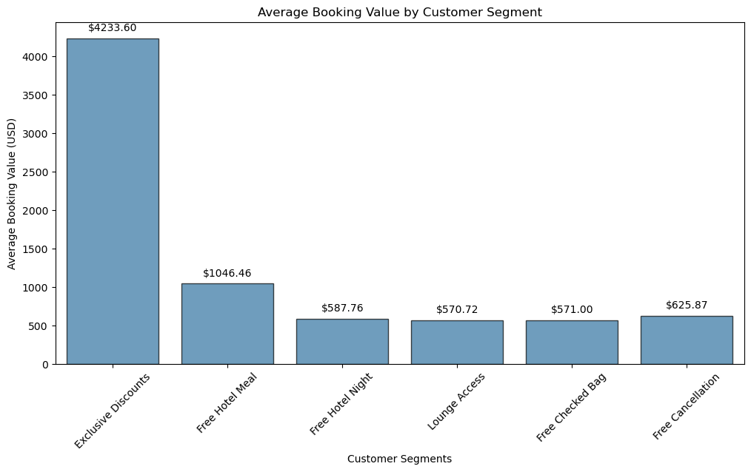
Key Findings: Who Are Our Customers?
Notes:
Let's focus on this bar chart, which encapsulates the average booking value for each of our customer segments. As you can observe, the 'Exclusive Discounts' segment has the highest average booking value, followed by 'Free Hotel Meal,' 'Free Hotel Night,' 'Lounge Access,' and finally, 'Free Cancellation.'
This chart serves as a concise visual summary, allowing us to quickly gauge the average spending in each segment. Understanding this is vital as we customize our rewards and incentives to meet the unique needs and behaviors of each segment.
It's important to note that these figures represent the average booking value, not the lifetime value, of customers in each segment. This gives us insights into the immediate revenue impact of each booking, which is crucial for short-term planning and offers.
Are there any questions about this summary before we proceed?

Slide 12
Recommendations: A/B Testing for Segment Validation
Objective: Validate the effectiveness of targeted perks for each customer segment.
Metrics: Conversion Rates, Customer Engagement
Timeline: 4-6 Weeks
Notes:
Let's dive into our first recommendation, which is A/B Testing for Segment Validation.
As we've identified distinct customer segments, it's crucial to validate that the targeted perks we're considering are indeed effective for each group. A/B testing allows us to do just that.
We propose a timeline of 4-6 weeks for this testing phase. During this period, we'll randomly assign customers from each segment to either a control group, which receives no perks, or a test group, which receives the targeted perk.
Our key performance indicators will be conversion rates and customer engagement. By comparing these metrics between the test and control groups, we can accurately measure the effectiveness of each perk.
This approach not only mitigates risk but also ensures that we're allocating resources to strategies that have a proven impact on customer behavior.
By the end of the testing phase, we aim to have actionable insights that will inform the full-scale launch of our rewards program.

Slide 13
Recommendations: Launch the Rewards Program
Targeted Email Campaign
Customized Perks for Each Segment
Personalized Messaging
Refine Segments
Focus on High-Value Customers
Tiered Rewards System
Key Performance Indicators
Customer Lifetime Value (CLV)
Engagement Rates
Timeline
Initial Rollout: 2 Weeks
First Evaluation: 1 Month
Notes:
Moving on to our next recommendation, we suggest launching a targeted email campaign based on the customer segments we've identified.
The beauty of segmentation is that it allows us to tailor our messaging and offers. We can further refine these segments based on average spend, enabling us to focus our efforts on high-value customers first.
Our key performance indicators for this initiative will be customer lifetime value and engagement rates. These metrics will give us a comprehensive view of how well the program is resonating with our customer base.
We propose an initial rollout period of two weeks, followed by a first evaluation after one month. This will allow us to make data-driven adjustments to the program as needed.
By aligning our rewards program with customer behavior and preferences, we aim to not only increase engagement but also elevate the overall customer experience.

Slide 14
Questions and Discussion

Slide 15
Thank You

